Slide 1

Aging issue
of Japan
By Yunho

Slide 2

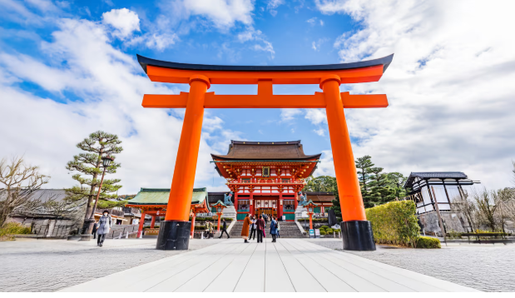
Japan
An East Asian island nation consisting of over 14,000 islands.
A unique fusion of deep-rooted traditions (Shinto and Buddhist customs) and cutting-edge modern technology, heavily emphasizing social harmony and respect for elders.
Japanese are spoken by over 99% of the population.

Slide 3
Japan, the “Silvertown”
Japan is having hard time with the aging population issue. Japan hit the title “the oldest world” by hitting over 30% of the population passed 65 old. In Canada, people can start claiming CPP(Canada Pension Plan) by 60 years old. That's not the only problem. Japan is currently losing around one million people from its total population annually.
As the world's fourth largest economy, Japan acts as a 'canary in the coal mine' for global aging, meaning its shrinking workforce could destabilize global supply chains while its successes or failures will serve as a roadmap for other developed nations.

Slide 4

Country's Actions
Japanese government is trying to solve the aging issue since now it’s being very bad problem. They made a lot of policy and rules.
But the problem..
Extending Working Age: Raised the retirement age to 70 to keep seniors in the workforce.
Pro-Natalist Policies: Increased childcare subsidies and parental leave benefits to boost birth rates.
Automation & Tech: Investing heavily in robotics and AI to fill labor gaps in elderly care and services.
Immigration Shift: Easing visa restrictions to attract more foreign workers into essential sectors.
Conservative Corporate Culture: Rigid work environments still make it hard for women to balance career and family.
Slow Social Integration: Cultural resistance limits the full social integration and long-term settlement of immigrants.
Delayed Structural Reform: Financial support alone has failed to address the root causes of the low birth rate.

Slide 5

The Reality & Consequences
Those solutions can solve lot of again issue problems. Such as..
All of those solution can be the answers but there can be some unintended consequences. Such as..
By extending the retirement age, more seniors are entering the workforce, effectively filling the severe labor shortage.
Due to insufficient pensions, many seniors cannot afford to retire and are forced to keep working past the age of 70, leading to a rise in elderly poverty.
Elderly-dominated jobs: Most taxi drivers and convenience store clerks have been replaced by seniors.
As the population completely vanishes, entire rural villages are turning into empty "ghost towns."

Slide 6

Canada or Japan?
Aging issue is also the problem in Canada. Canada government is also trying hard to catch the problem right. The problem are the same but the solution is way different.
Canada is trying to solve the issue by
Massive Immigration: Welcoming skilled newcomers to keep the population and workforce growing
Flexible Pension: Citizens can start claiming the Canada Pension Plan (CPP) at 60 years old
Key Difference
Canada relies on migrator to maintain the average age of Canada population but Japan relies on robot and senior.
Japan is trying to solve the issue by
Automation & Senior Labor: Relying on robotics and keeping their own elderly citizens in the workforce instead of opening borders
Extended Work: Encouraging citizens to work until 70 years old due to a shrinking tax base

Slide 7

A Roadmap for Our Future
We should care about Japan’s aging issue because unfortunately Canada is also aging. Aging issue is not very problem in Canada right now because the population is not decreasing. But the fact is that population is also not growing. Soon, Canada will also get in to trouble with aging issue as Japan. Japan is the roadmap for our future.
If they successfully solve this problem, we can copy the solution but if they fails some how, we can at least avoid the option what Japan chose right now. Japan is a crystal ball showing the future challenges that Canada must prepare for today

Slide 8
Thank you for your time
Japan is showing us the future challenges that Canada must prepare for today

Slide 9

Resource:
http://brunch.co.kr/@kid008/378
https://ko.wikipedia.org/wiki/%EC%9D%BC%EB%B3%B8%EC%9D%98_%EA%B3%A0%EB%A0%B9%ED%99%94
https://en.wikipedia.org/wiki/Aging_of_Canada

